Slide 1
Moreau-Yosida Parallel Tempering
MTH496: Undergraduate Project I
Lipika Bagai (230604)
Supervisor: Prof. Dootika Vats
Department of Mathematics and Statistics
IIT Kanpur

Slide 2
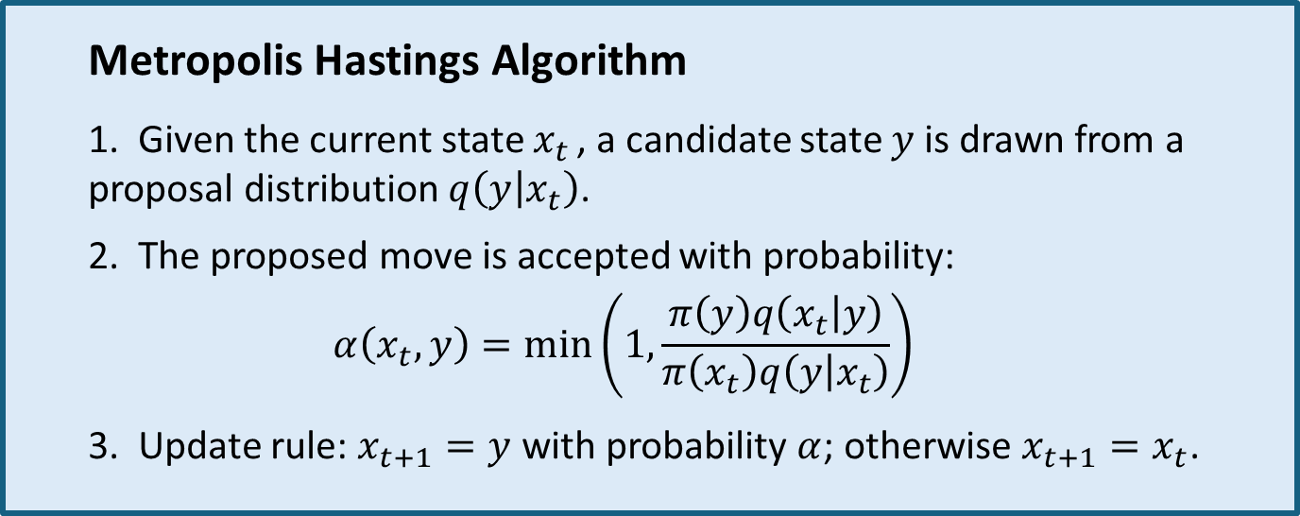
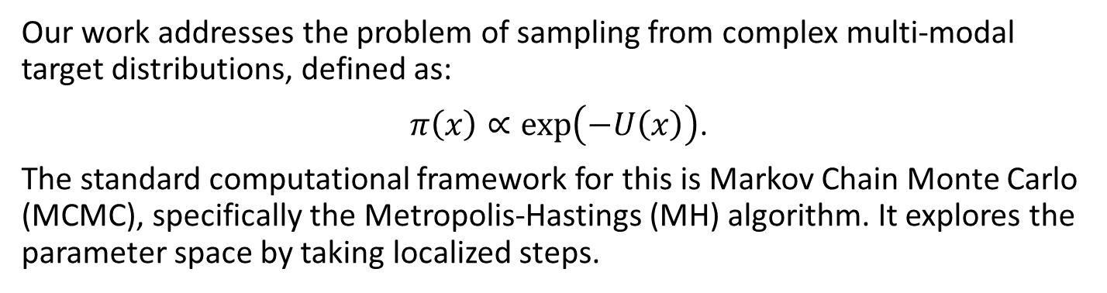
Sampling Problem
Our work addresses the problem of sampling from complex multi-modal target distributions, defined as:
$π\left(x\right)∝\exp\left(−U\left(x\right)\right)$.
The standard computational framework for this is Markov Chain Monte Carlo (MCMC), specifically the Metropolis-Hastings (MH) algorithm. It explores the parameter space by taking localized steps.
Metropolis Hastings Algorithm
1. Given the current state $x_{t}$ , a candidate state $y$ is drawn from a proposal distribution $q\left(y | x_{t}\right)$.
2. The proposed move is accepted with probability:
$$α\left(x_{t},y\right)=\min\left(1,\frac{π\left(y\right)q\left(x_{t} | y\right)}{π\left(x_{t}\right)q\left(y | x_{t}\right)}\right)$$
3. Update rule: $x_{t+1}=y$ with probability $α$; otherwise $x_{t+1}=x_{t}$.

Slide 3
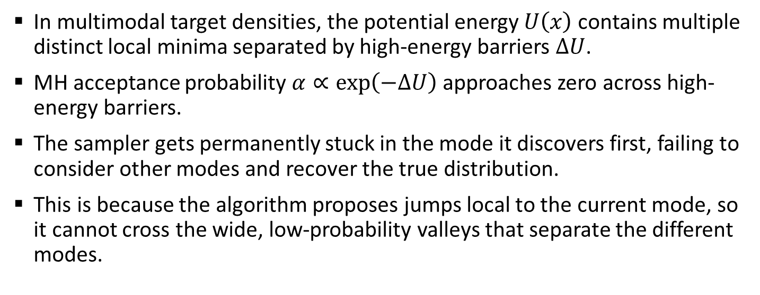
The Challenge of Mode Entrapment
In multimodal target densities, the potential energy $U\left(x\right)$ contains multiple distinct local minima separated by high-energy barriers $ΔU$.
MH acceptance probability $α∝exp\left(−ΔU\right)$approaches zero across high-energy barriers.
The sampler gets permanently stuck in the mode it discovers first, failing to consider other modes and recover the true distribution.
This is because the algorithm proposes jumps local to the current mode, so it cannot cross the wide, low-probability valleys that separate the different modes.

Slide 4
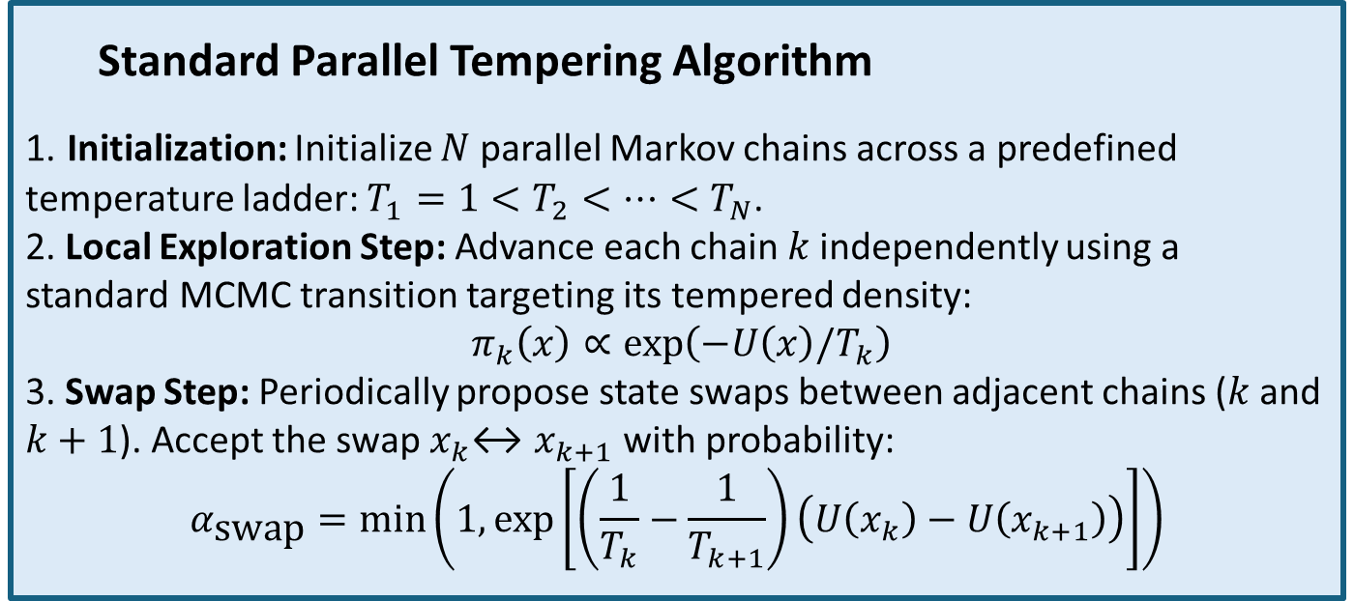
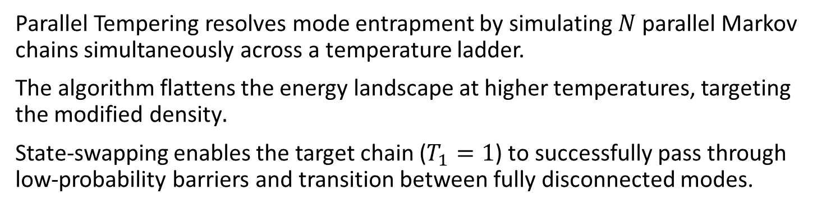
Overcoming Entrapment: Parallel Tempering
Parallel Tempering resolves mode entrapment by simulating $N$ parallel Markov chains simultaneously across a temperature ladder.
The algorithm flattens the energy landscape at higher temperatures, targeting the modified density$.$
State-swapping enables the target chain ($T_{1}=1$) to successfully pass through low-probability barriers and transition between fully disconnected modes.
Standard Parallel Tempering Algorithm
1. Initialization: Initialize $N$ parallel Markov chains across a predefined temperature ladder: $T_{1}=1<T_{2}<…<T_{N}$.
2. Local Exploration Step: Advance each chain$k$independently using a standard MCMC transition targeting its tempered density:
$π_{k}\left(x\right)∝\exp\left(−U\left(x\right)/T_{k}\right)$
3. Swap Step: Periodically propose state swaps between adjacent chains ($k$and $k+1$). Accept the swap${ x}_{k}↔x_{k+1}$ with probability:
$$α_{\text{swap}}=\min\left(1,\exp\left[\left(\frac{1}{T_{k}}−\frac{1}{T_{k+1}}\right)\left(U\left(x_{k}\right)−U\left(x_{k+1}\right)\right)\right]\right)$$

Slide 5
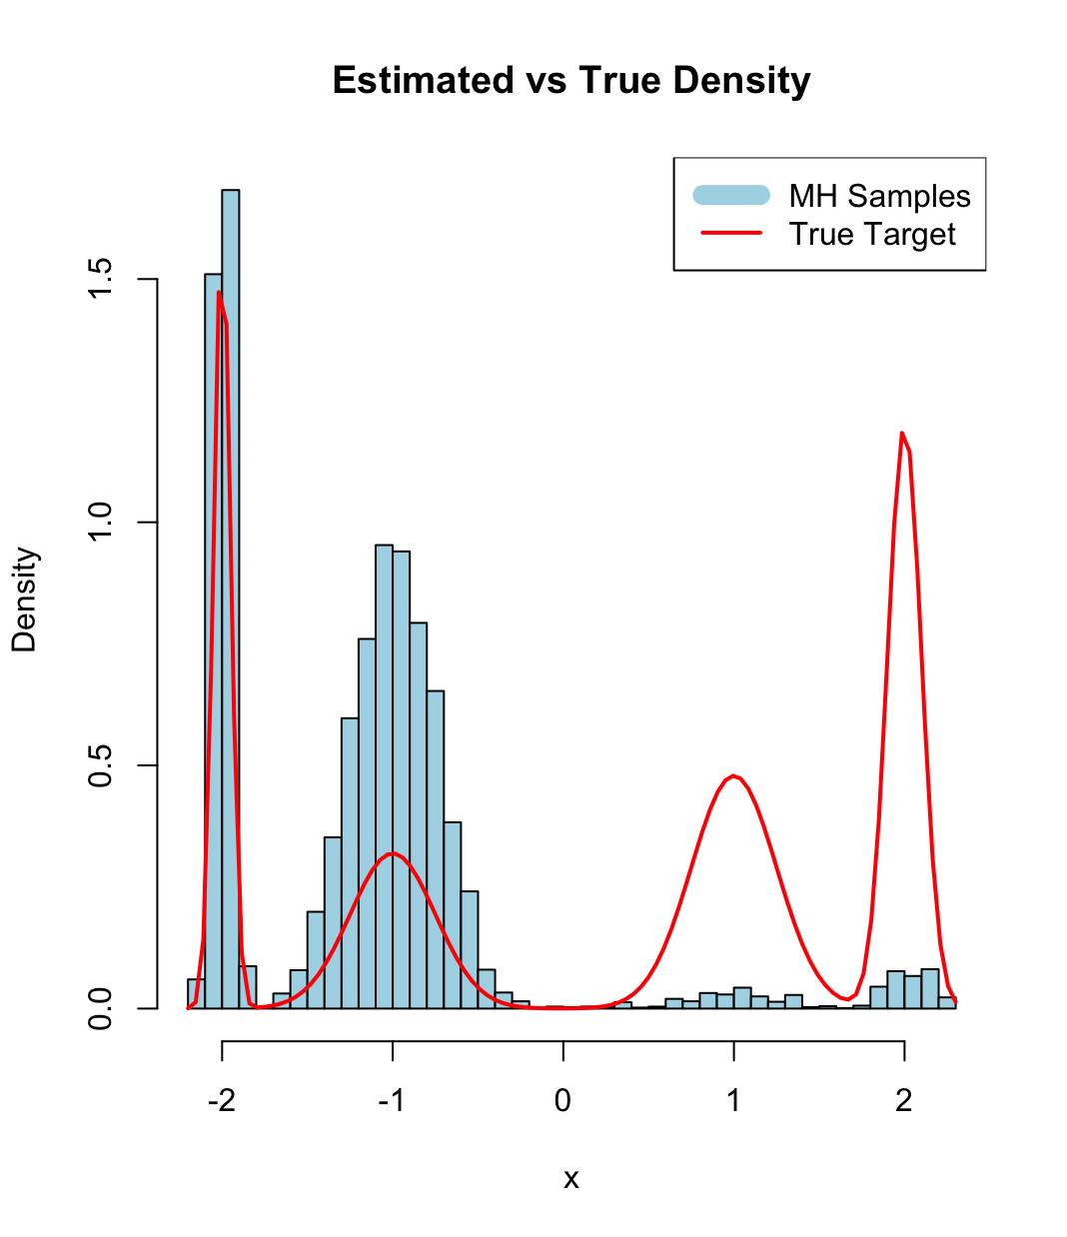
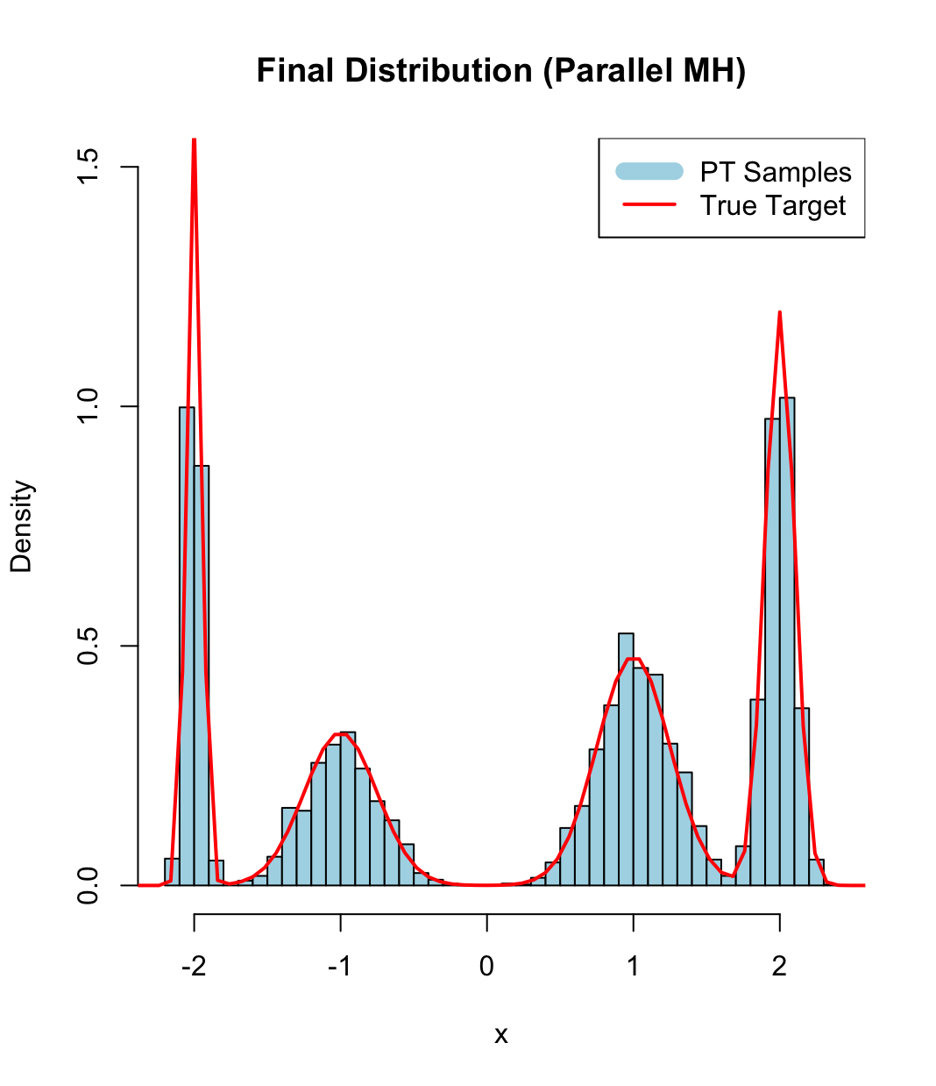
Empirical Comparison: MH vs. PT
Target: A highly multimodal 4-component Gaussian mixture model.
MH Failure (Left): The standard MH algorithm remains trapped locally, yielding a severely correlated and incomplete representation of the target density.
PT Resolution (Right): Parallel Tempering resolves mode entrapment by using high-temperature chains to help the target chain escape local minima and sample multiple isolated modes.

Slide 6
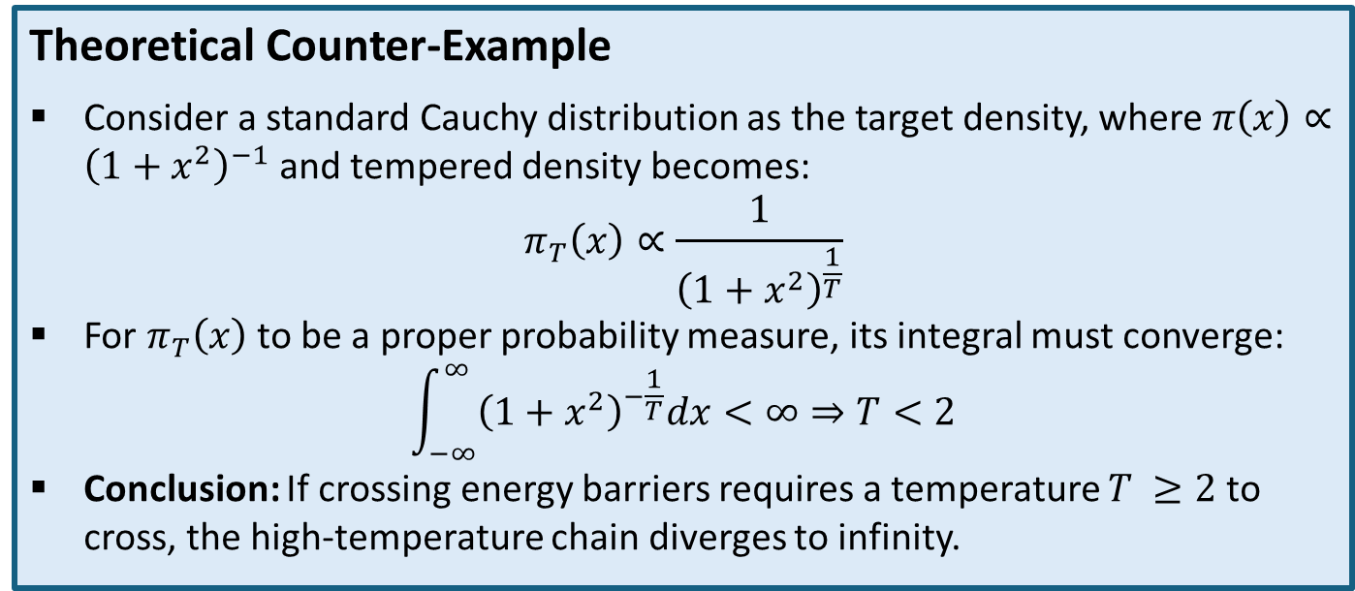
Integrability Limitation of Temperature Scaling
Standard Parallel Tempering relies on fractional power scaling to geometrically thicken target tails, which is effective for rapidly decaying distributions (e.g., Gaussian) but fails for those exhibiting polynomial decay.
For heavy-tailed distributions, high temperatures break the algorithm by yielding improper, non-integrable probability densities.
Theoretical Counter-Example
Consider a standard Cauchy distribution as the target density, where$π\left(x\right)∝{\left(1+x^{2}\right)}^{−1}$and tempered density becomes:
$$π_{T}\left(x\right)∝\frac{1}{{\left(1+x^{2}\right)}^{\frac{1}{T}}}$$
For${ π}_{T}\left(x\right)$to be a proper probability measure, its integral must converge:
$$\int_{−∞}^{∞}{{\left(1+x^{2}\right)}^{−\frac{1}{T}}dx}<∞⇒T<2$$
Conclusion: If crossing energy barriers requires a temperature $T ≥2$ to cross, the high-temperature chain diverges to infinity.

Slide 7
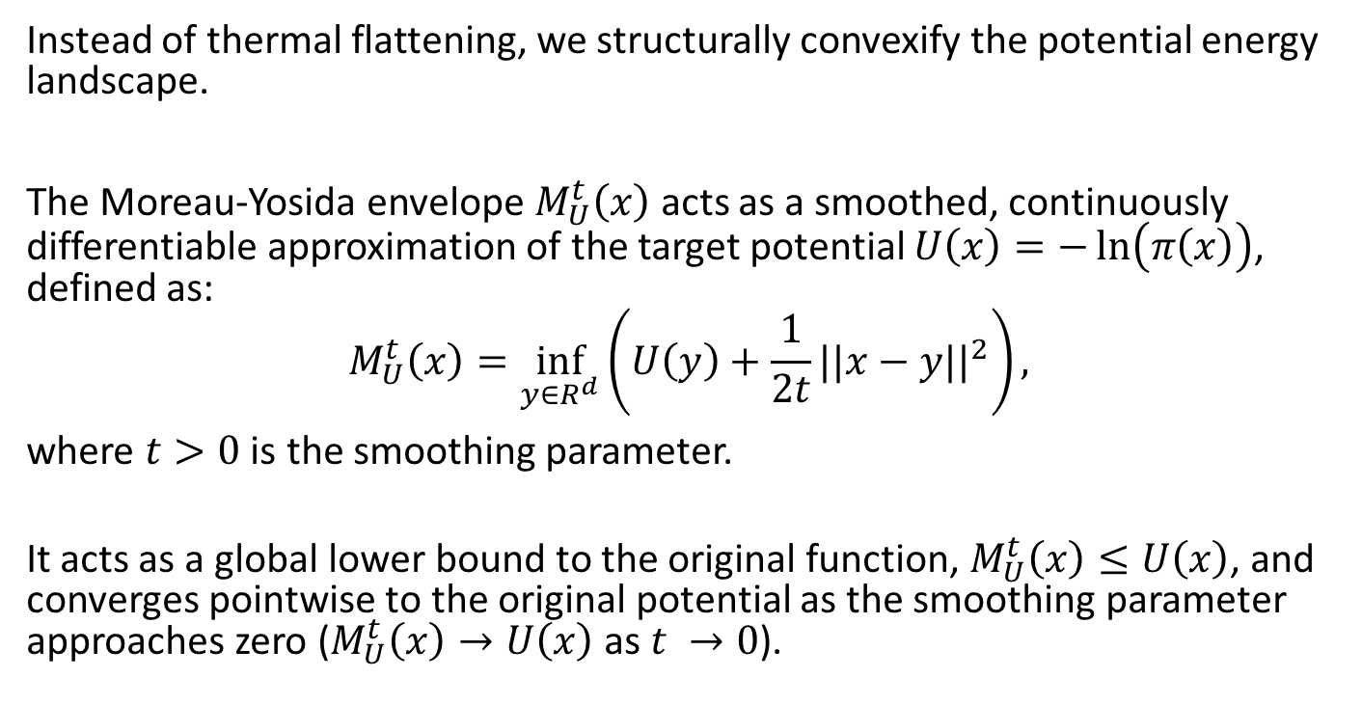
The Solution: Moreau-Yosida Envelopes
Instead of thermal flattening, we structurally convexify the potential energy landscape.
The Moreau-Yosida envelope$M_{U}^{t}\left(x\right)$acts as a smoothed, continuously differentiable approximation of the target potential $U\left(x\right)=−\ln\left(π\left(x\right)\right)$, defined as:
$$M_{U}^{t}\left(x\right)=\inf_{y∈R^{d}}\left(U\left(y\right)+\frac{1}{2t}||x−y||^{2}\right),$$
where $t>0$ is the smoothing parameter.
It acts as a global lower bound to the original function,${ M}_{U}^{t}\left(x\right)≤U\left(x\right)$, and converges pointwise to the original potential as the smoothing parameter approaches zero ($M_{U}^{t}\left(x\right)→U\left(x\right)$ as $t →0$).

Slide 8
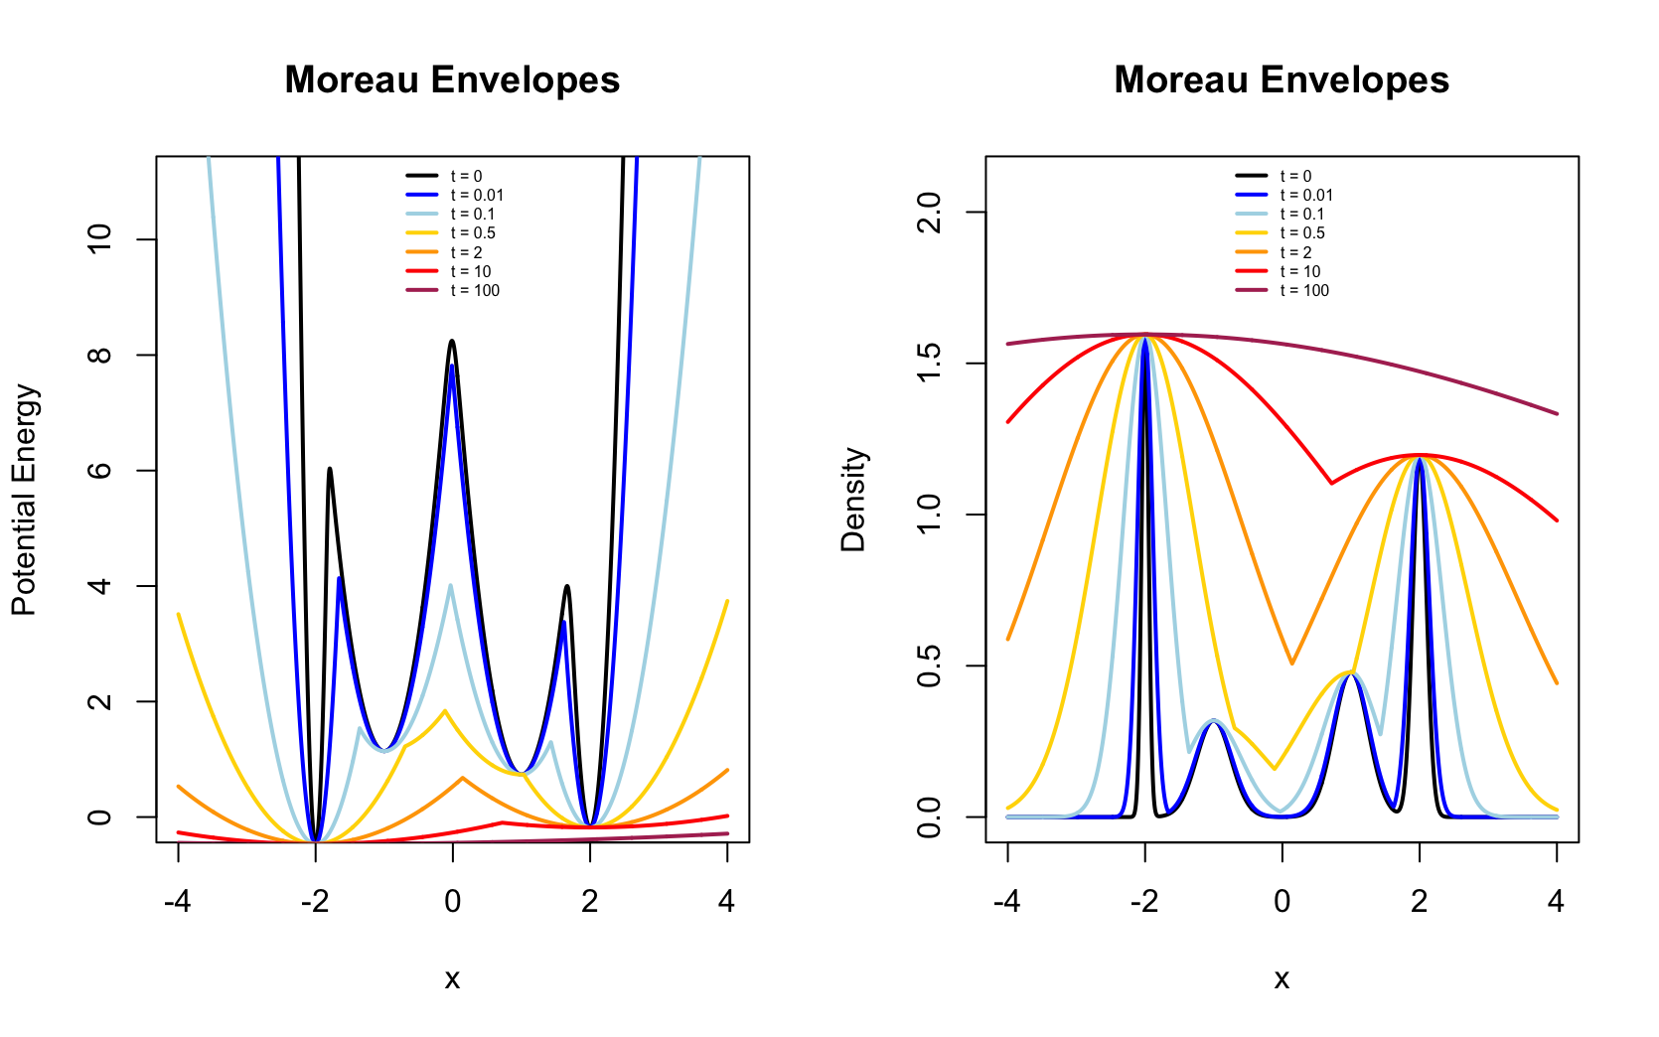

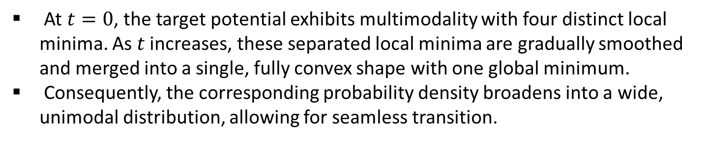
Effect of Smoothing Parameter $t$
At $t=0$, the target potential exhibits multimodality with four distinct local minima. As $t$ increases, these separated local minima are gradually smoothed and merged into a single, fully convex shape with one global minimum.
Consequently, the corresponding probability density broadens into a wide, unimodal distribution, allowing for seamless transition.

Slide 9
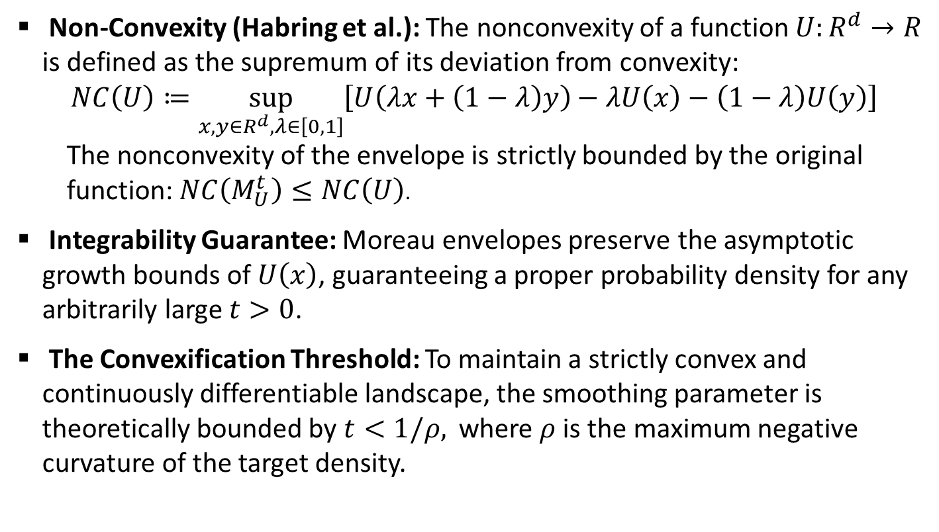
Theoretical Guarantees: Integrability & Convexification
Non-Convexity (Habring et al.): The nonconvexity of a function $U:R^{d}→R$ is defined as the supremum of its deviation from convexity:
$NC\left(U\right)≔\sup_{x,y∈R^{d},λ∈\left[0,1\right]}\left[U\left(λx+\left(1−λ\right)y\right)−λU\left(x\right)−\left(1−λ\right)U\left(y\right)\right]$
The nonconvexity of the envelope is strictly bounded by the original function: $NC\left(M_{U}^{t}\right)≤NC\left(U\right)$.
Integrability Guarantee: Moreau envelopes preserve the asymptotic growth bounds of $U\left(x\right)$, guaranteeing a proper probability density for any arbitrarily large $t>0$.
The Convexification Threshold: To maintain a strictly convex and continuously differentiable landscape, the smoothing parameter is theoretically bounded by $t<1/ρ,$where $ρ$is the maximum negative curvature of the target density.

Slide 10
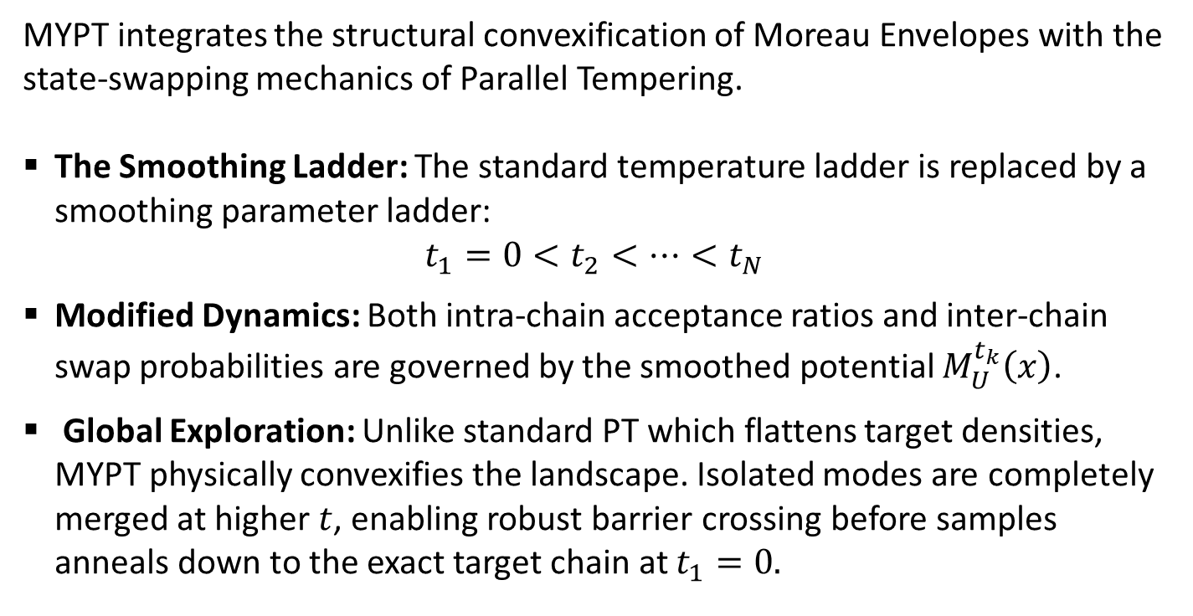
Moreau-Yosida Parallel Tempering (MYPT)
MYPT integrates the structural convexification of Moreau Envelopes with the state-swapping mechanics of Parallel Tempering.
The Smoothing Ladder: The standard temperature ladder is replaced by a smoothing parameter ladder:
$$t_{1}=0<t_{2}<…<t_{N}$$
Modified Dynamics: Both intra-chain acceptance ratios and inter-chain swap probabilities are governed by the smoothed potential $M_{U}^{t_{k}}\left(x\right)$.
Global Exploration: Unlike standard PT which flattens target densities, MYPT physically convexifies the landscape. Isolated modes are completely merged at higher $t$, enabling robust barrier crossing before samples anneals down to the exact target chain at $t_{1}=0.$

Slide 11
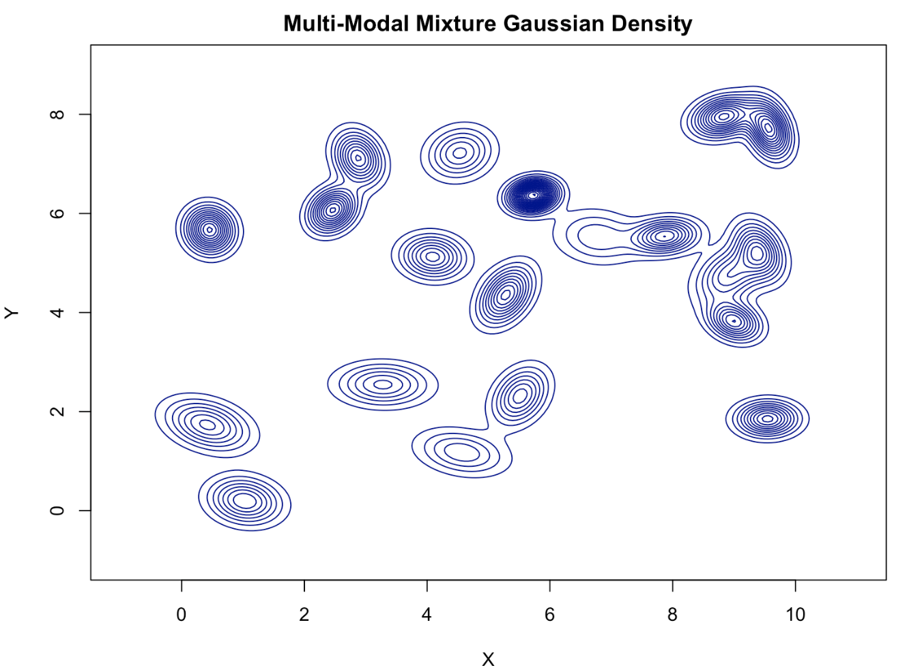
Example: 20-Mode Gaussian Mixture
To evaluate global mode-hopping capabilities, the algorithms are applied to a severely multimodal, asymmetric 2D Gaussian mixture comprising 20 distinct modes.
These modes are randomly scattered across the parameter space with varying covariance structures, correlations, and component weights.

Slide 12
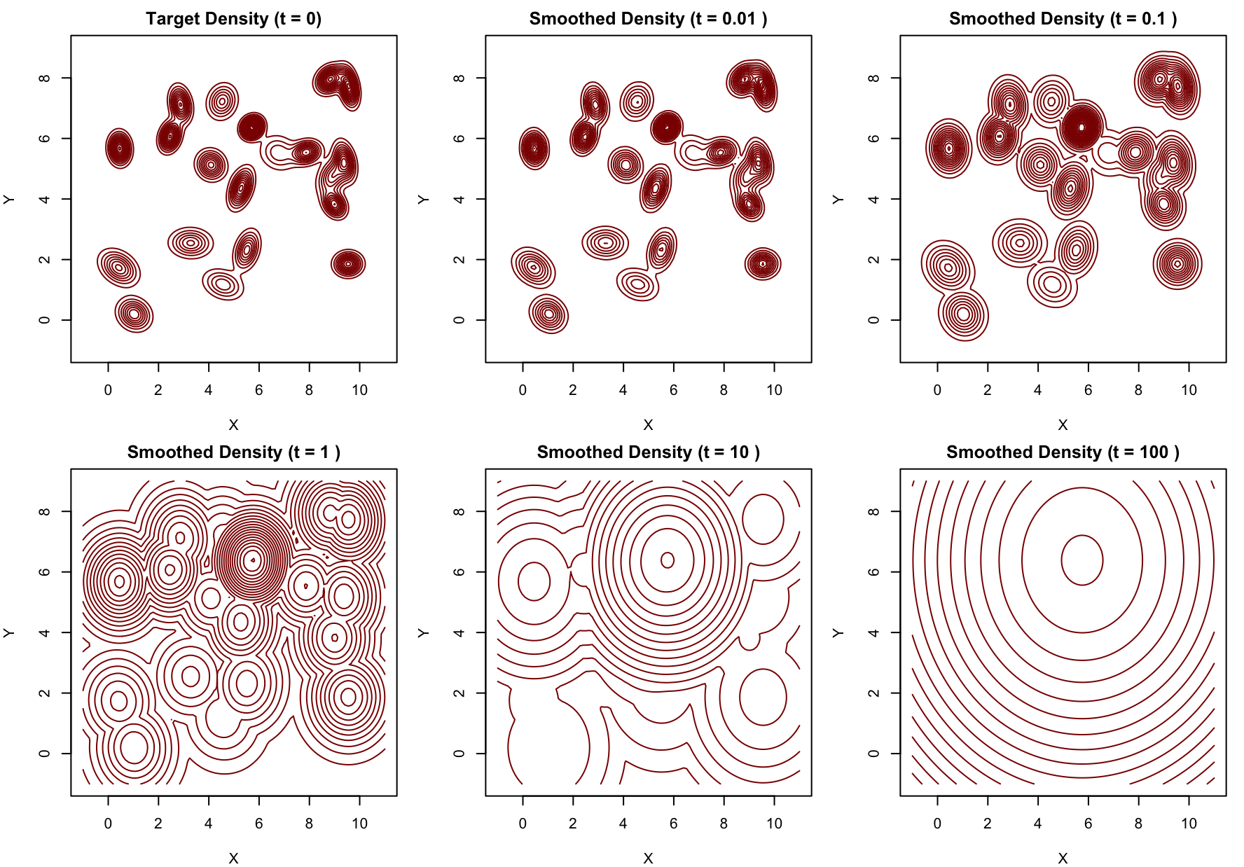
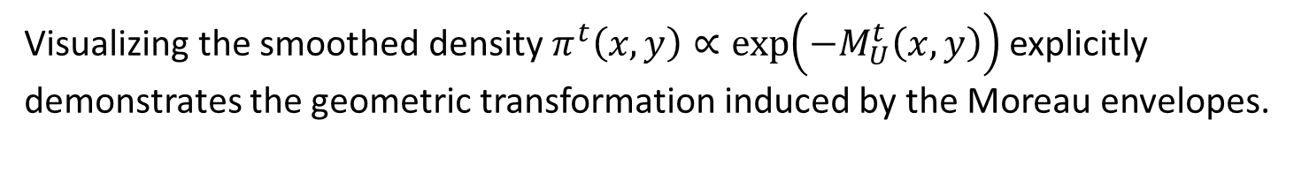
Structural Transformation Across the Ladder
Visualizing the smoothed density $π^{t}\left(x,y\right)∝\exp\left(−M_{U}^{t}\left(x,y\right)\right)$ explicitly demonstrates the geometric transformation induced by the Moreau envelopes.

Slide 13
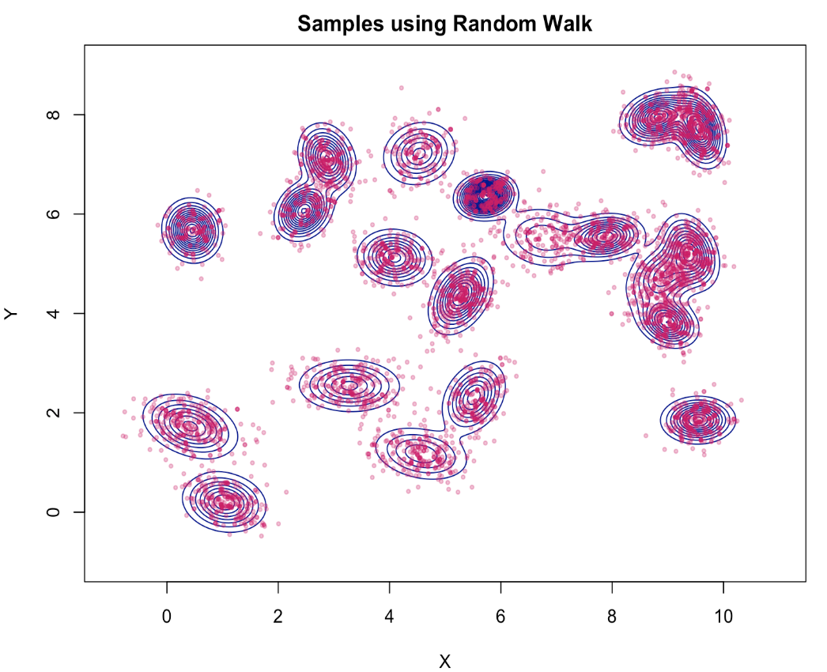
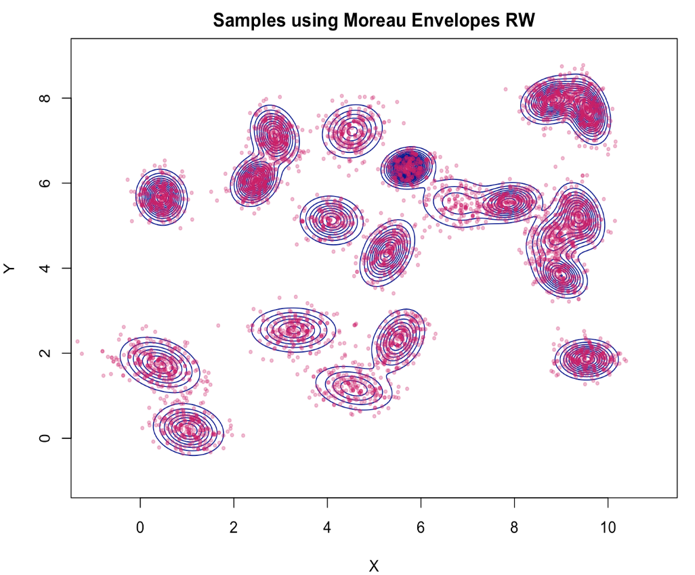
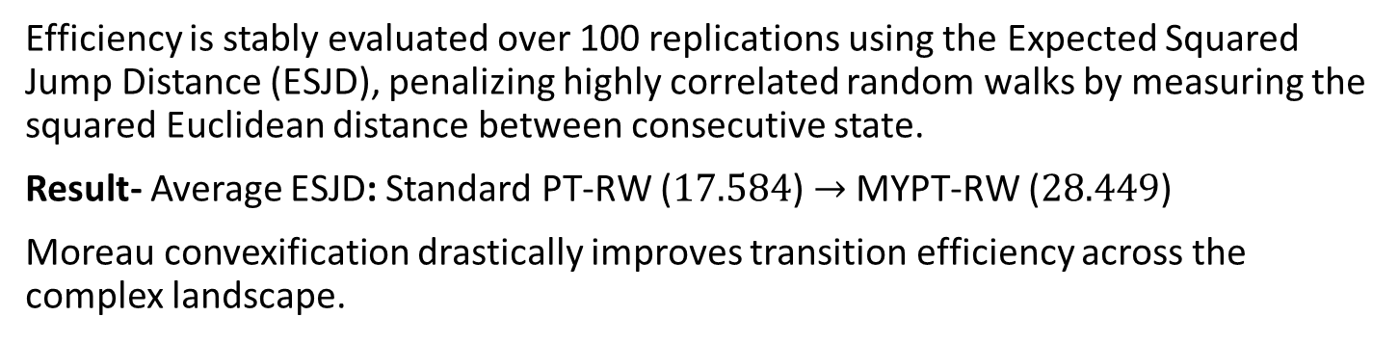
Sampling Results & Quantitative Efficiency
Efficiency is stably evaluated over 100 replications using the Expected Squared Jump Distance (ESJD), penalizing highly correlated random walks by measuring the squared Euclidean distance between consecutive state.
Result- Average ESJD: Standard PT-RW ($17.584$) $→$MYPT-RW ($\text{28.449}$)
Moreau convexification drastically improves transition efficiency across the complex landscape.

Slide 14
Conclusion
Framework Development: Proposed and implemented Moreau-Yosida Parallel Tempering (MYPT), integrating swapping mechanism with structural convexification.
Theoretical Resolution: Overcomes the integrability flaws of thermal scaling, guaranteeing proper, integrable target densities across all smoothing levels.
Geometric Transformation: Replaces fractional power scaling with Moreau envelopes to systematically merge isolated minima and resolve mode entrapment.
Empirical Performance: Achieves significantly superior transition efficiency (ESJD) and robust global exploration across severely multimodal landscapes.

Slide 15
Thank You!

Slide 16
References
Habring, A., Falk, A., Zach, M., & Pock, T. (2026). "Diffusion at Absolute Zero: Langevin Sampling Using Successive Moreau Envelopes." SIAM (arXiv:2502.01358).
Vats, D., Shukla, A., & Chi, E. C. (2025). "MCMC Importance Sampling via Moreau-Yosida Envelopes." arXiv preprint arXiv:2501.02228.
Durmus, A., Moulines, E., & Pereyra, M. (2018). "Efficient Bayesian Computation by Proximal Markov Chain Monte Carlo." SIAM Journal on Imaging Sciences, 11(1), 473-506.
Park, T., & Casella, G. (2008). "The Bayesian Lasso." Journal of the American Statistical Association, 103(482), 681–686.
Geyer, C. J. (2005). "Some Markov Chain Theory." Stat 8931 Class Notes, University of Minnesota.

